Slide 1
Learn to anticipate
Chana Ross
December 2019

Slide 2
Problem definition
Mathematical breakdown of problem
Anticipatory planner – mathematical background
Example – uber , Manhattan
Data analysis
Probability function
Deterministic problem solvers
Anticipatory algorithm
Results
Future work
Summary
Table of contents

Slide 3
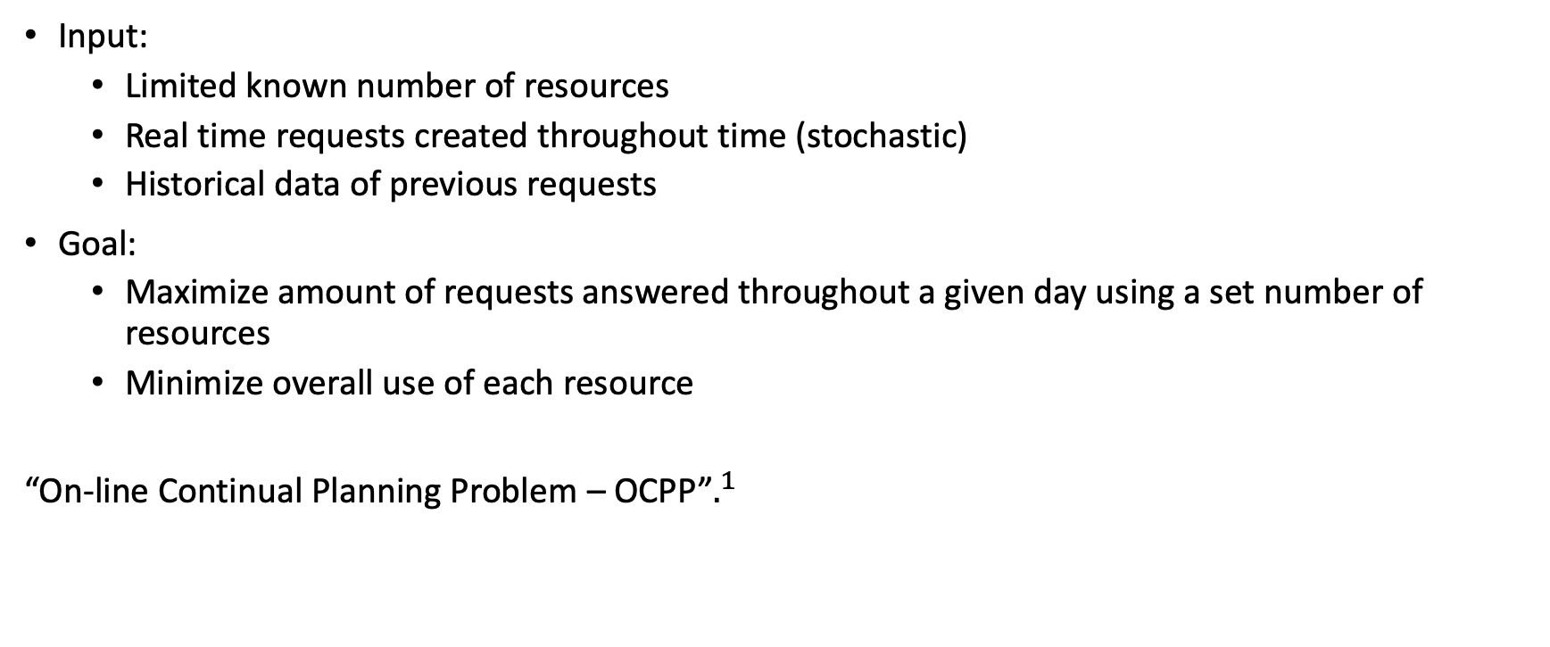
Problem - definition
Input:
Limited known number of resources
Real time requests created throughout time (stochastic)
Historical data of previous requests
Goal:
Maximize amount of requests answered throughout a given day using a set number of resources
Minimize overall use of each resource
“On-line Continual Planning Problem – OCPP”$.^{1}$
Anticipatory on-line planning, ICAPS’12
Ethan Burns, J. Benton, Wheeler Ruml, Sungwook Yoon, and Minh B. Do.

Slide 4
input
Limited known number of resources
Goal
Maximize amount of requests answered throughout a given day using a set number of resources
Real time requests created throughout time (stochastic)
Historical data of previous requests
Minimize overall use of each resource
“On-line Continual Planning Problem – OCPP”
Problem Definition
Anticipatory on-line planning, ICAPS’12
Ethan Burns, J. Benton, Wheeler Ruml, Sungwook Yoon, and Minh B. Do.

Slide 5
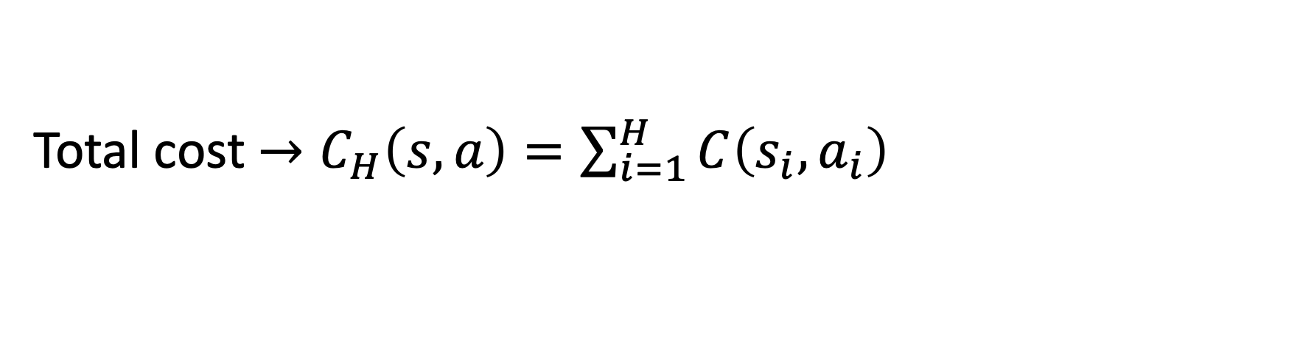
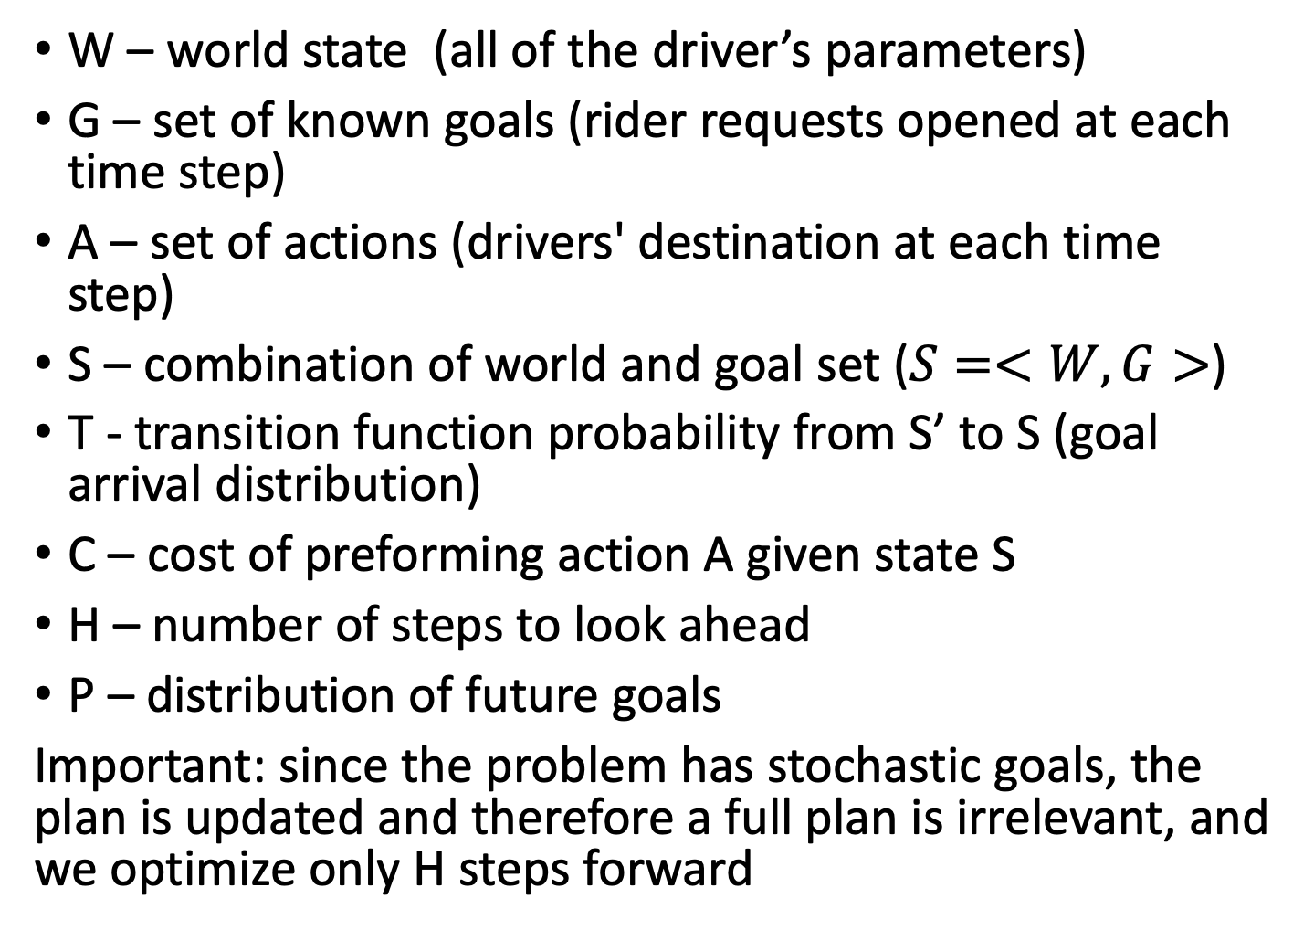
W – world state (all of the driver’s parameters)
G – set of known goals (rider requests opened at each time step)
A – set of actions (drivers' destination at each time step)
S – combination of world and goal set ($S=<W,G>$)
T - transition function probability from S’ to S (goal arrival distribution)
C – cost of preforming action A given state S
H – number of steps to look ahead
P – distribution of future goals
Important: since the problem has stochastic goals, the plan is updated and therefore a full plan is irrelevant, and we optimize only H steps forward
OCPP - Problem Definition
Total cost $→C_{H}\left(s,a\right)=\sum_{i=1}^{H}{C\left(s_{i},a_{i}\right)}$

Slide 6
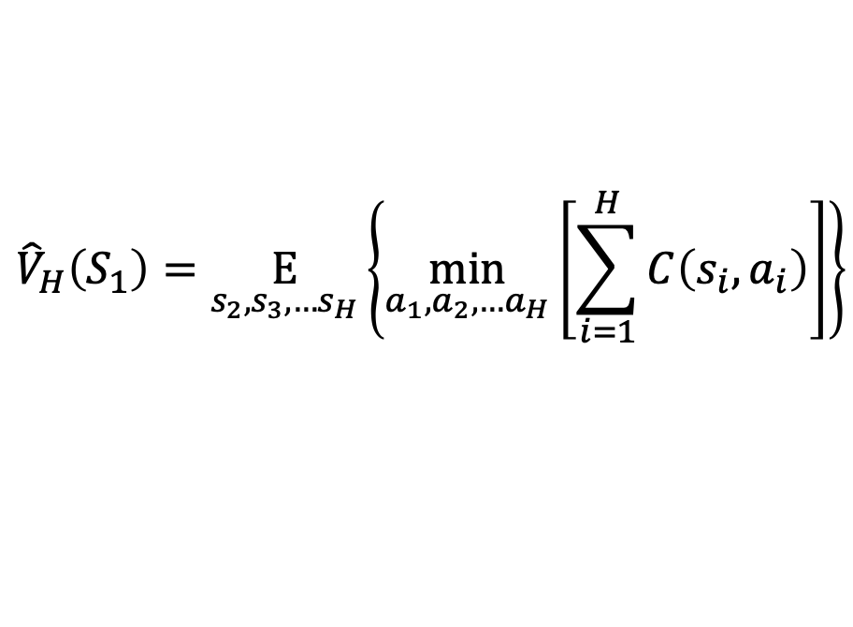
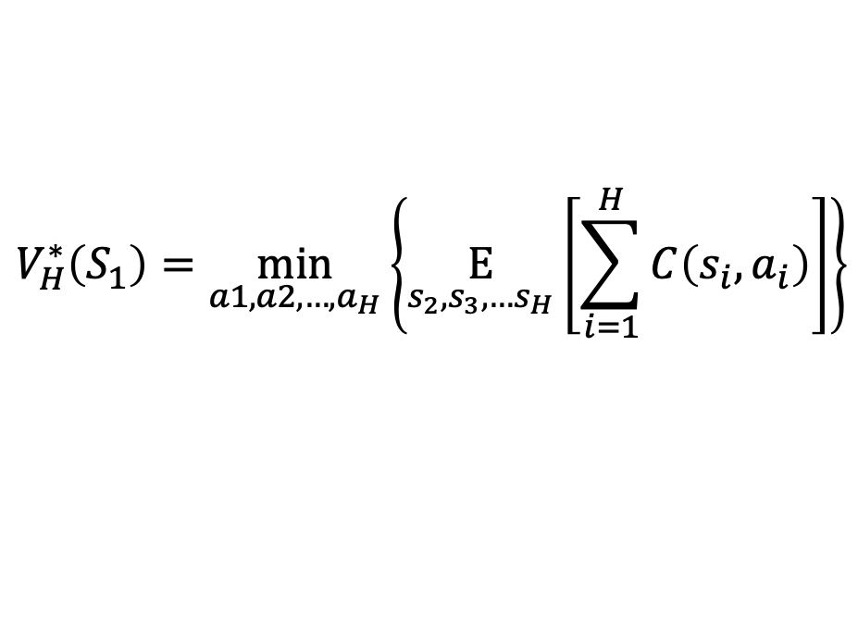

Expected value of being in state S1.
Computation is costly (optimization minimization needs to account for all future possible horizons)
Exchanging expectation and minimization –
We will use the Q function instead of the value function -
$$V_{H}^{∗}\left(S_{1}\right)=\min_{a1,a2,…,a_{H}}\left\{\underset{s_{2},s_{3},…s_{H}}{E}\left[\sum_{i=1}^{H}{C\left(s_{i},a_{i}\right)}\right]\right\}$$
Anticipatory planner – mathematical background
$${\hat{V}}_{H}\left(S_{1}\right)=\underset{s_{2},s_{3},…s_{H}}{E}\left\{\min_{a_{1},a_{2},…a_{H}}\left[\sum_{i=1}^{H}{C\left(s_{i},a_{i}\right)}\right]\right\}$$
$$\hat{Q}\left(s_{1},a_{1}\right)=C\left(s_{1},a_{1}\right)+{\hat{V}}_{H}\left(S_{1}\right)$$

Slide 7
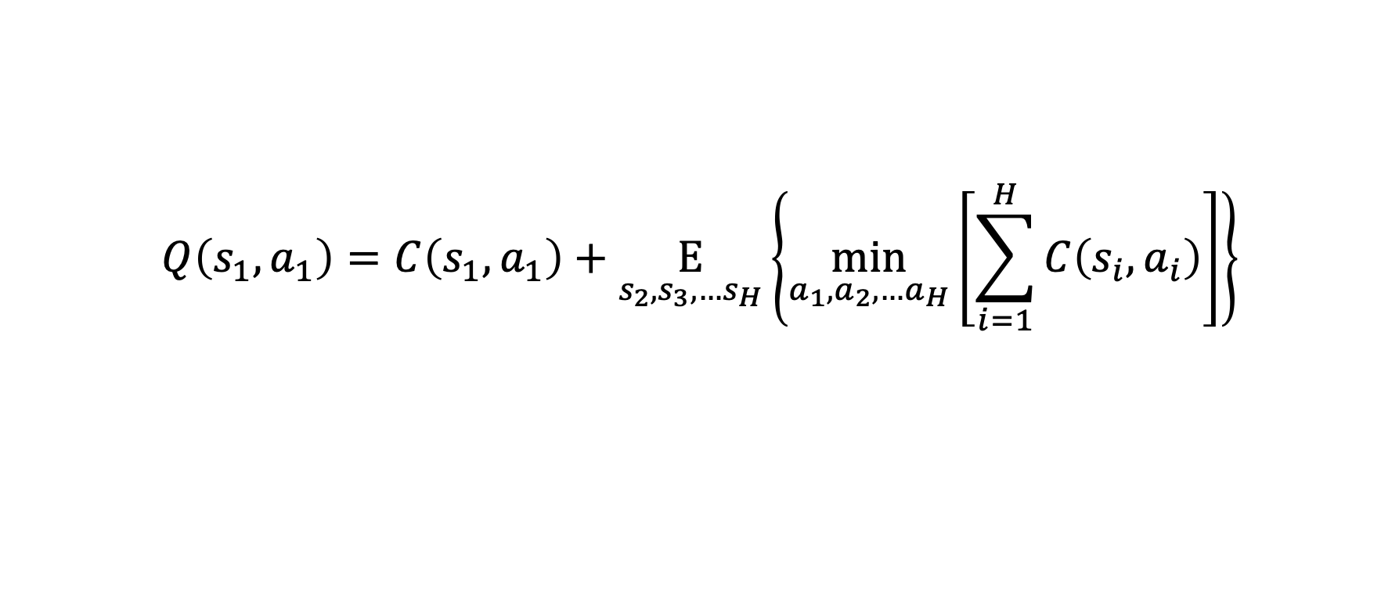
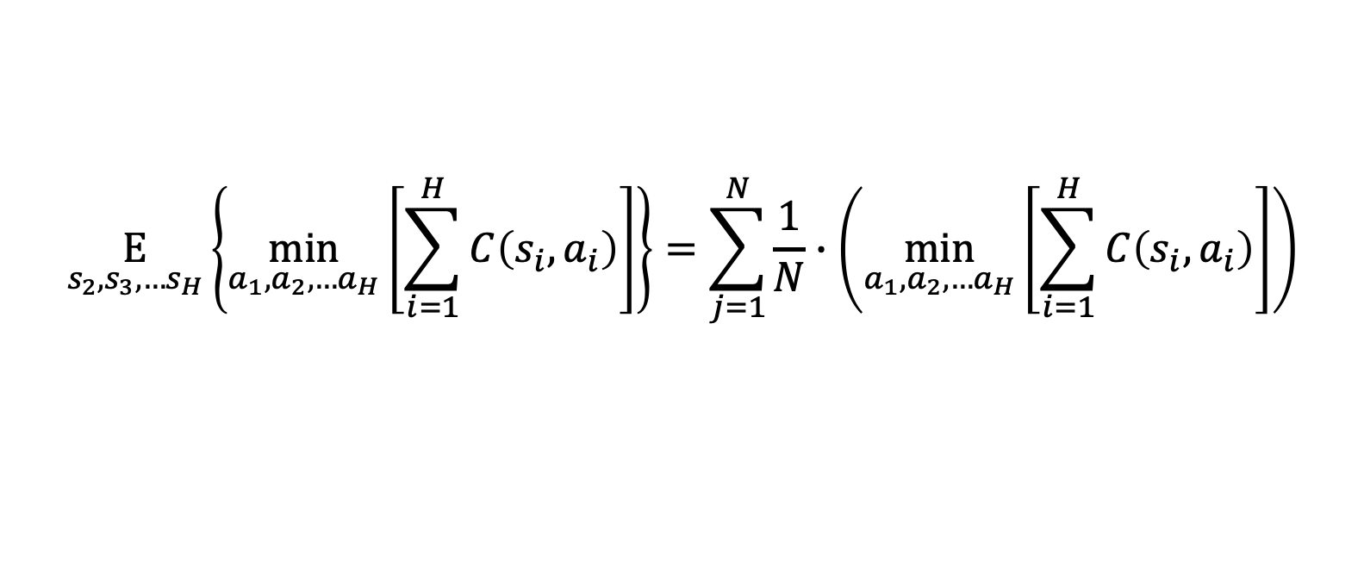
Expected goals from distribution
$$Q\left(s_{1},a_{1}\right)=C\left(s_{1},a_{1}\right)+\underset{s_{2},s_{3},…s_{H}}{E}\left\{\min_{a_{1},a_{2},…a_{H}}\left[\sum_{i=1}^{H}{C\left(s_{i},a_{i}\right)}\right]\right\}$$
Anticipatory planner - explained
Real cost of moving each vehicle and picking up goals reached
Deterministic problem of real goals and future goals sampled from known distribution
$$\underset{s_{2},s_{3},…s_{H}}{E}\left\{\min_{a_{1},a_{2},…a_{H}}\left[\sum_{i=1}^{H}{C\left(s_{i},a_{i}\right)}\right]\right\}=\sum_{j=1}^{N}{\frac{1}{N}∙\left(\min_{a_{1},a_{2},…a_{H}}\left[\sum_{i=1}^{H}{C\left(s_{i},a_{i}\right)}\right]\right)}$$
N = num stochastic runs

Slide 8
 | “Anticipatory online planning” Bernie et al. | Our solution
Problem Size | 3 agents 7*7 grid P(1 event) = 0.04 | 5+ agents 50*10 grid (not limited) P(multiple events) > 0.1
Distribution | Known function | Learned from historical data
Deterministic Solver (run time) | A* Slow run time Limited problem size | MIP Fast (max flow) Problem size unlimited
What’s new?

Slide 9
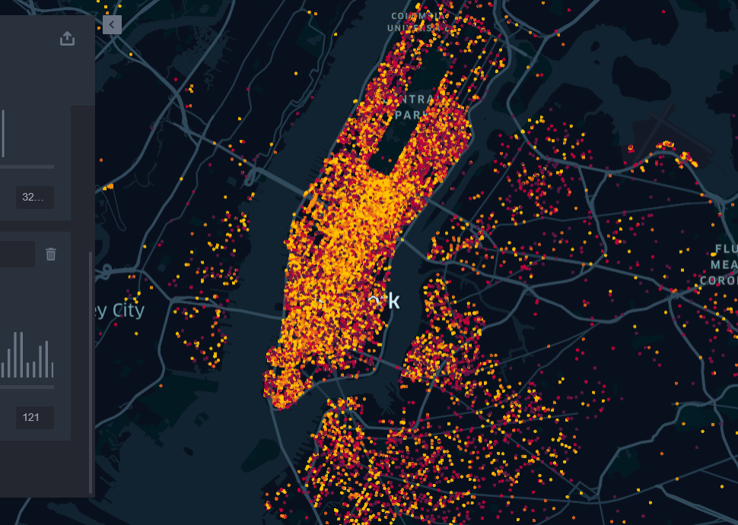
Example – Uber Manhattan

Slide 10
Data
Input
April - September 2014
https://github.com/fivethirtyeight/uber-tlc-foil-response
Number of available drivers
Stochastic requests throughout the day
Goal
Baseline
Minimize route for each driver
Maximize amount of requests answered
Deterministic optimal solution
Greedy linear sum assignment based on distance matrix
Problem Definition Uber

Slide 11
Problem assumptions
Each costumer is picked up at a known location (data did not include drop off locations)
Costumers have a time window before canceling their request (this time is unknown to the algorithm)
Each car has 5 possible actions : {up, down, left, right, stay}
Cost : [reward for pickup] - [cancelation fee] - [driving fee]

Slide 12
1. Data Analysis
Organize data
Understand patterns (if exist)
2. learning prediction function
learn the historical data and create probability function to estimate expected value of actions
3. Deterministic solver
Find solver for calculating expected value of deterministic runs
4. anticipatory algorithm
5. Accelerate run time
run anticipatory algorithm and compare to baselines
improve run time and run on large-scale problems
Steps for solution

Slide 13
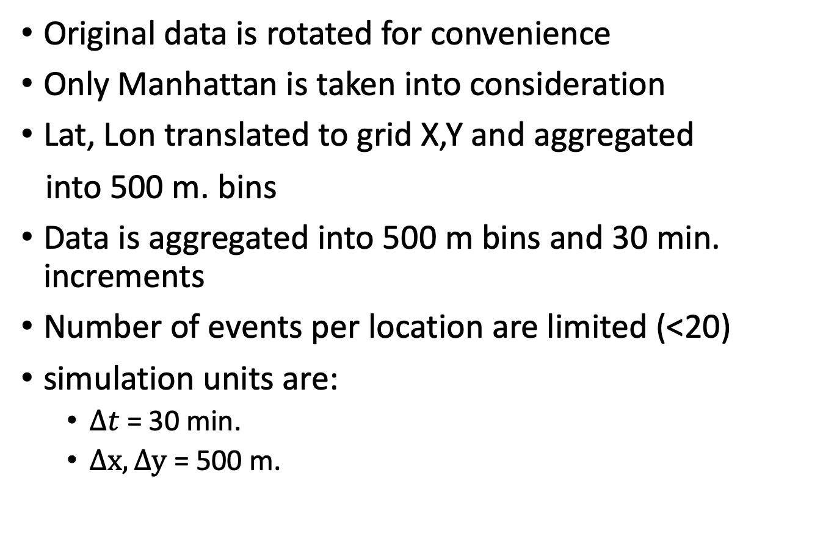
Original data is rotated for convenience
Only Manhattan is taken into consideration
Lat, Lon translated to grid X,Y and aggregated
into 500 m. bins
Data is aggregated into 500 m bins and 30 min. increments
Number of events per location are limited (<20)
simulation units are:
$Δt$ = 30 min.
$Δx,Δy$ = 500 m.
Step 1 : Data analysis

Slide 14
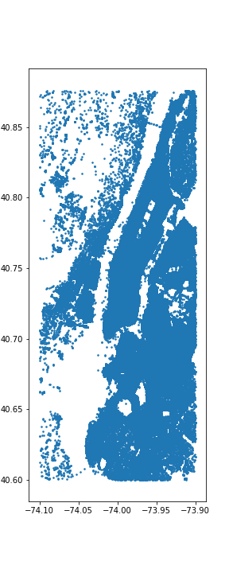
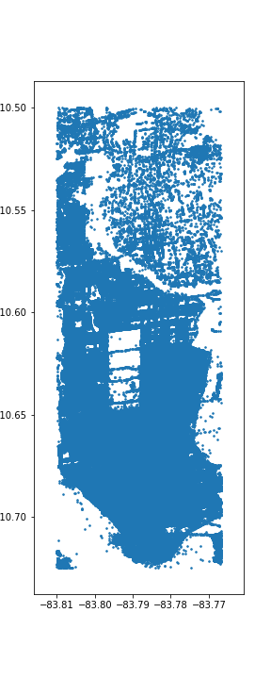
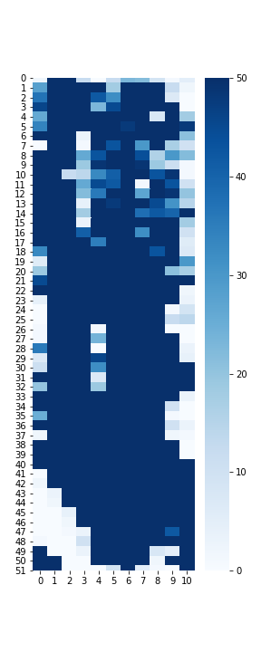
Original data
Rotated + Cropped data
Aggregated into grid
Step 1 : Data analysis
Central park

Slide 15
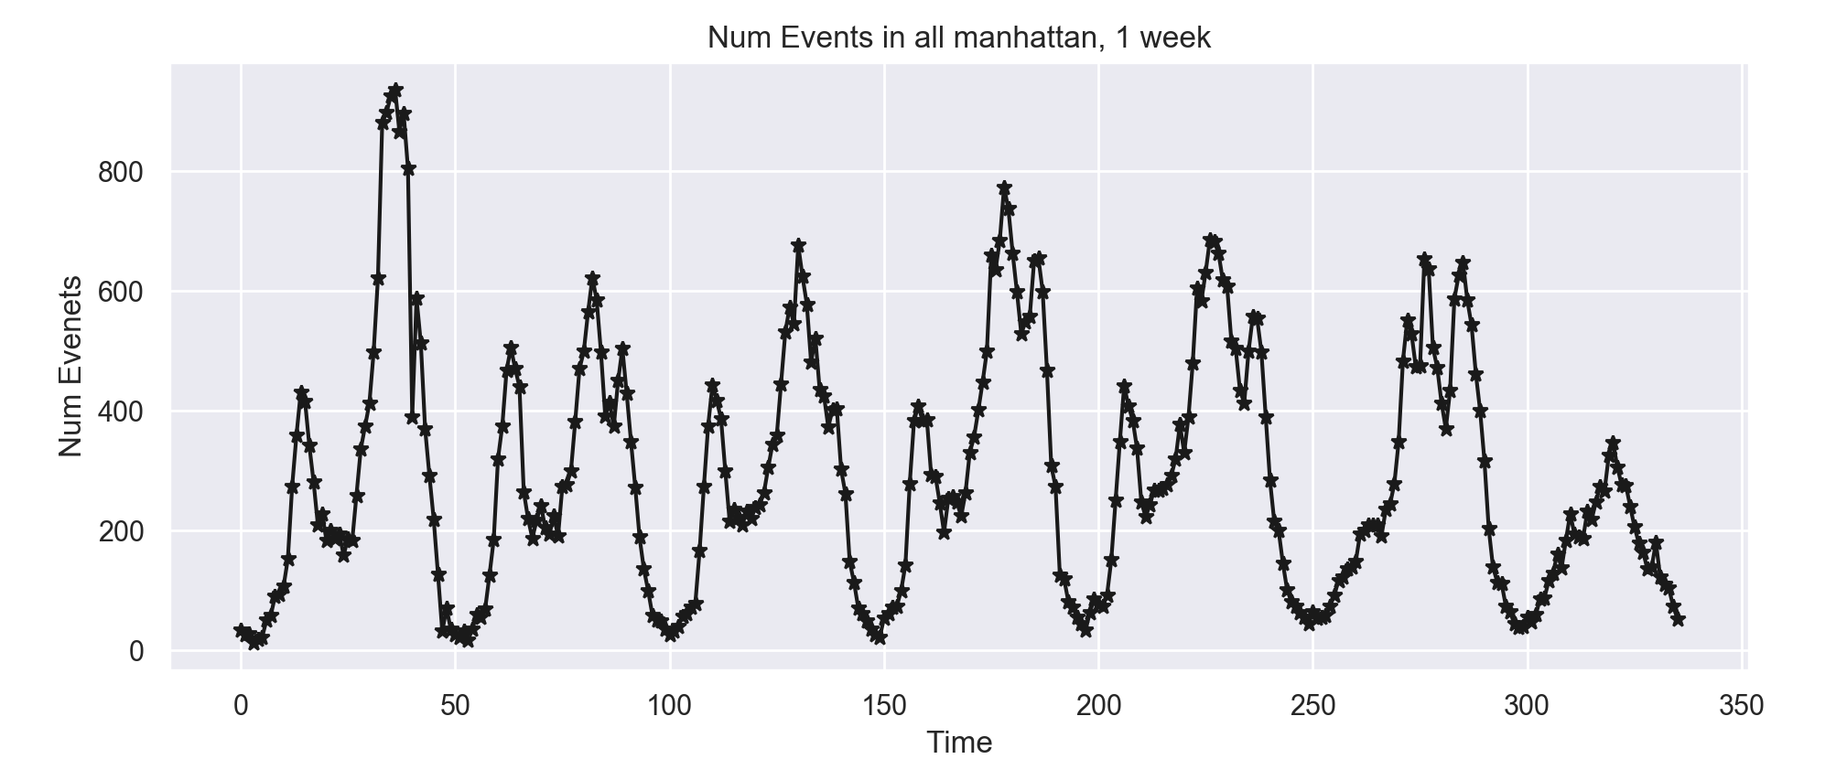
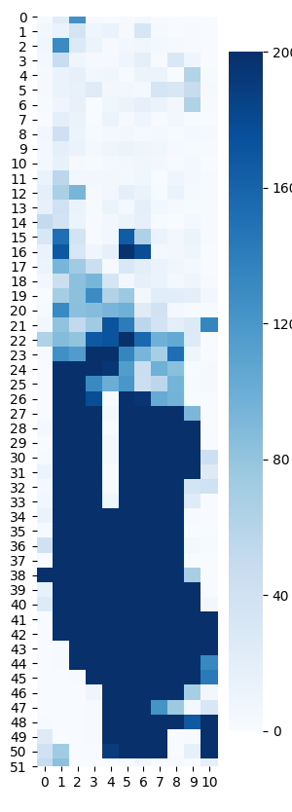
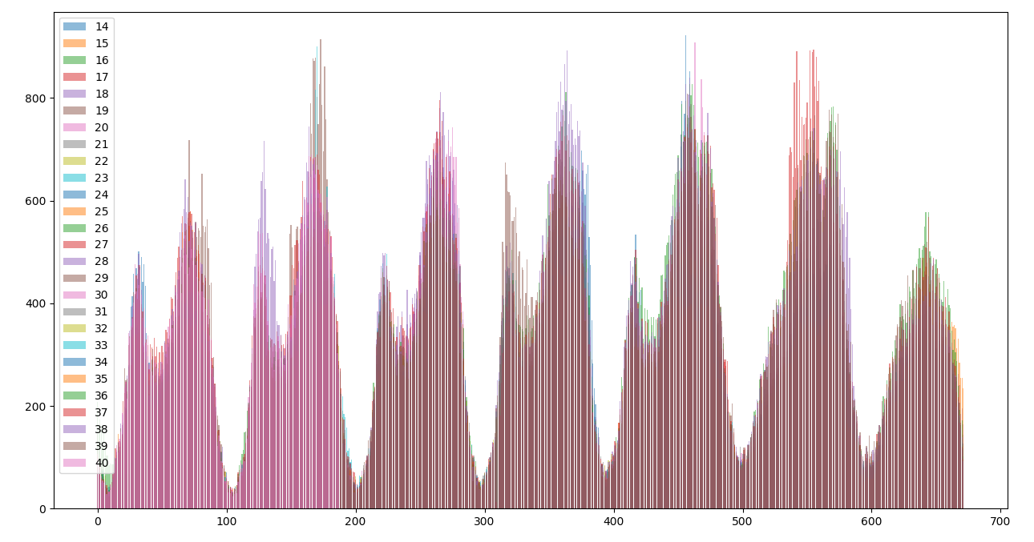
Temporal distribution, all locations, 1 week
Spatial Distribution , 1 week
Step 1 : Data analysis
All weeks have similar behavior

Slide 16
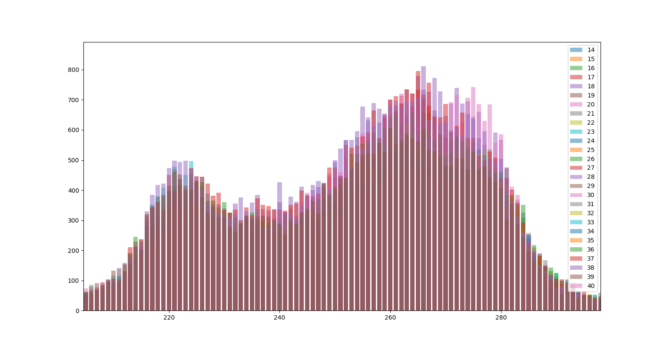
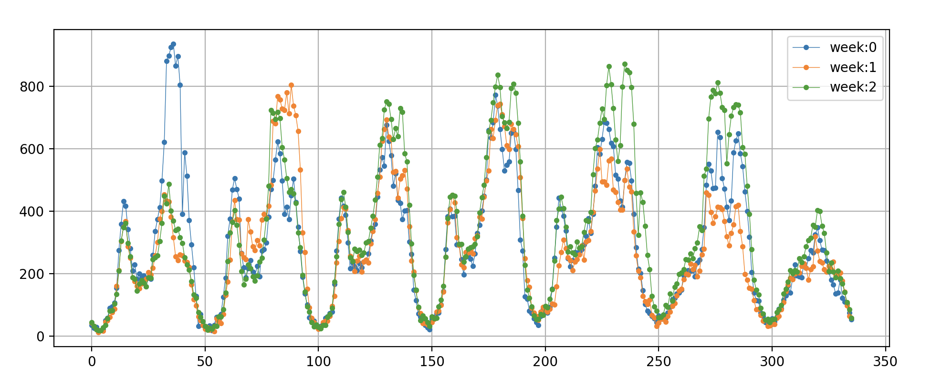
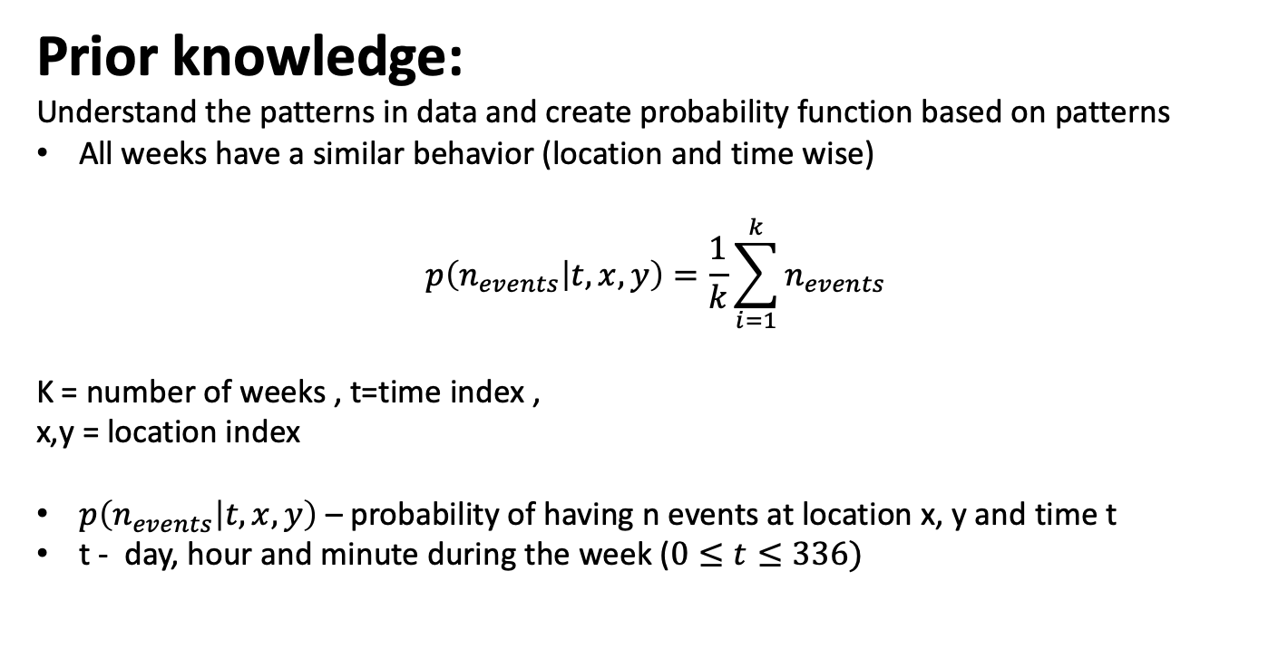
Prior knowledge:
Understand the patterns in data and create probability function based on patterns
All weeks have a similar behavior (location and time wise)
$$p\left(n_{events} | t,x,y\right)=\frac{1}{k}\sum_{i=1}^{k}{n_{events}}$$
K = number of weeks , t=time index ,
x,y = location index
$p\left(n_{events} | t,x,y\right)$ – probability of having n events at location x, y and time t
t - day, hour and minute during the week ($0≤t≤336)$
Step 2 : Probability Function, Average
Evening peak home
Morning peak to work

Slide 17
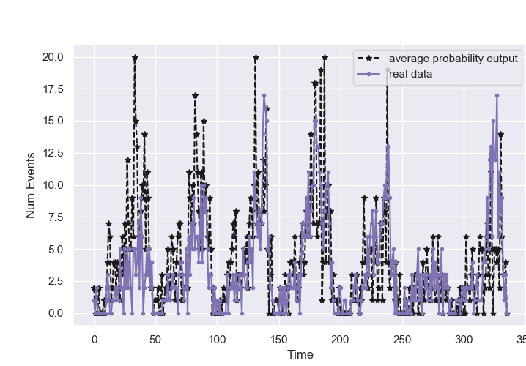
Step 2 : Probability Function, Average

Slide 18
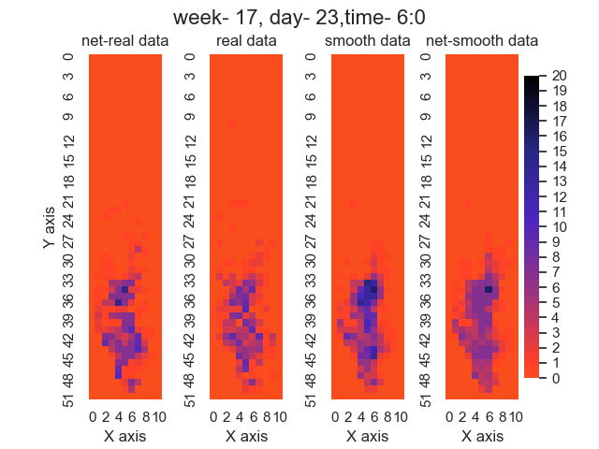
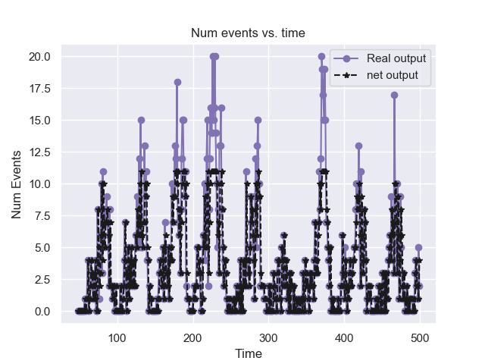
Data is sparse and therefore the network was trained on a busy node and then validated and tested on other nodes. (LSTM + FC network)
Network was evaluated on two types of data: raw, smooth
Step 2 : Probability Function, Machine Learning
Network results compared to raw data on busy location

Slide 19
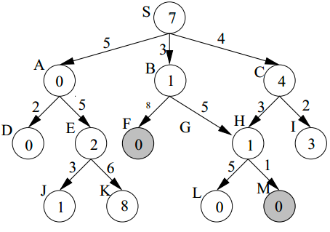
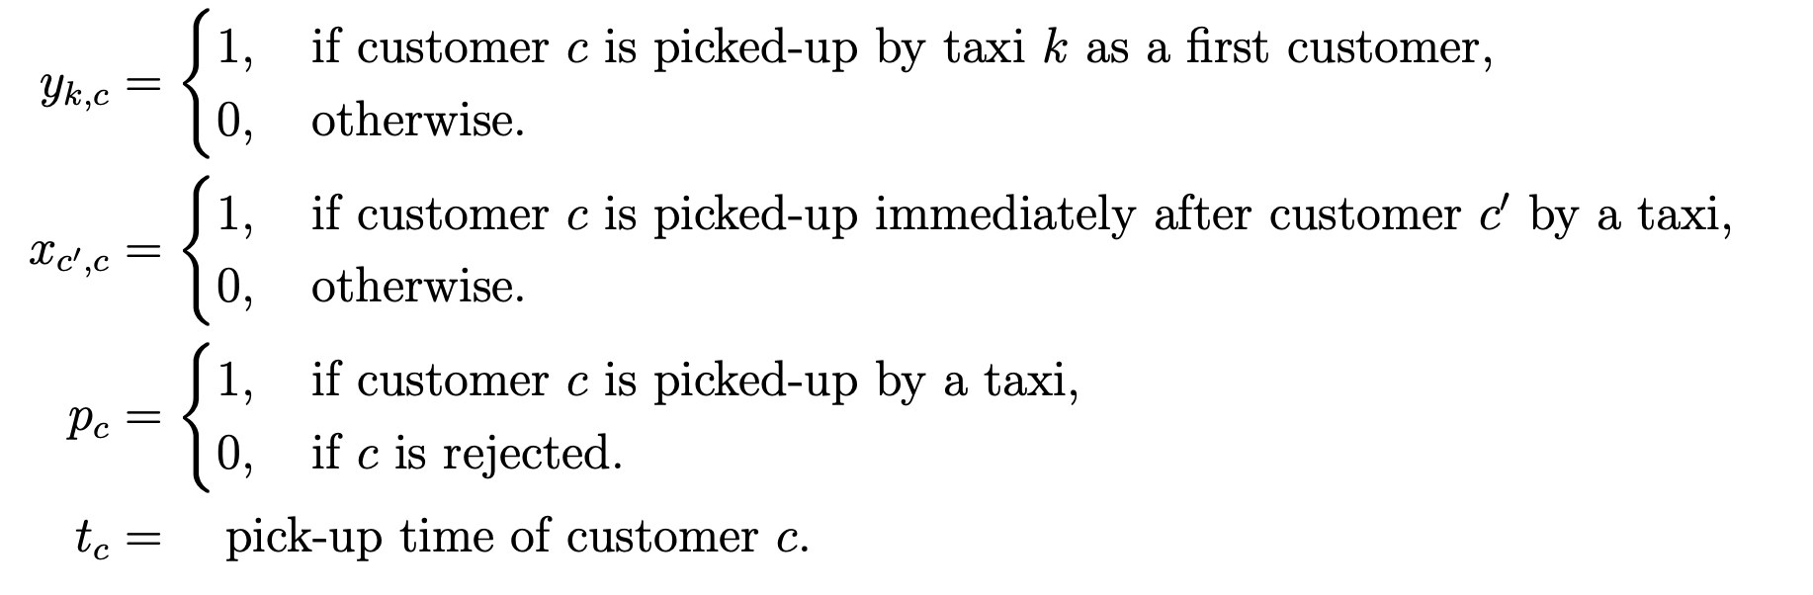
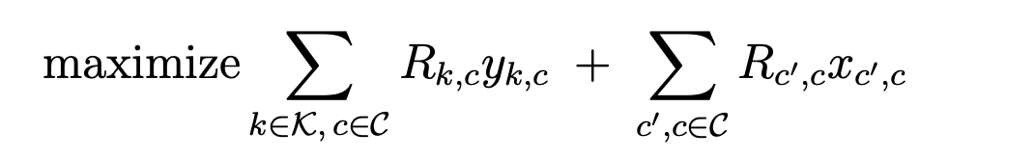
A* :
Find shortest path assuming the actual cost of each edge and the approximate future cost. Method uses BFS algorithm
MIP :
Find solution to optimization problem where the edges of the graphs are the unknown variables of optimization problem
Reinforcement learning :
Learn the combined optimal policy for all cars using reinforcement learning methods
Step 3 : Deterministic solver
In the process …

Slide 20
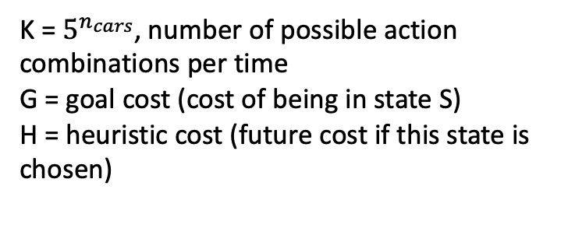
State:
Request information -
Location
Time until opened
Time until closed
Status (closed/opened)
Reward for reaching request
Penalty for canceling request
Car information –
Current location
List of requests reached
Step 3 :
A* explained
S1
$$s_{1,1}$$
𝑠_1,1
$$s_{1,3}$$
𝑠_1,3
$$S_{1,k}$$
𝑆_(1,𝑘)
$$s_{1,2}$$
𝑠_1,2
$$s_{1,1,1}$$
𝑠_1,1,1
$$s_{1,1,2}$$
𝑠_1,1,2
$$s_{1,1,k}$$
𝑠_(1,1,𝑘)
$$s_{1,2,1}$$
𝑠_1,2,1
$$s_{1,2,2}$$
𝑠_1,2,2
$$s_{1,2,k}$$
𝑠_(1,2,𝑘)
$$s_{1,3,1}$$
𝑠_1,3,1
$$s_{1,3,2}$$
𝑠_1,3,2
$$s_{1,3,k}$$
𝑠_(1,3,𝑘)
$$s_{1,k,1}$$
𝑠_(1,𝑘,1)
$$s_{1,k,2}$$
𝑠_(1,𝑘,2)
$$s_{1,k,k}$$
𝑠_(1,𝑘,𝑘)
…
K = $5^{n_{cars}}$, number of possible action combinations per time
G = goal cost (cost of being in state S)
H = heuristic cost (future cost if this state is chosen)
…
…
…
…

Slide 21
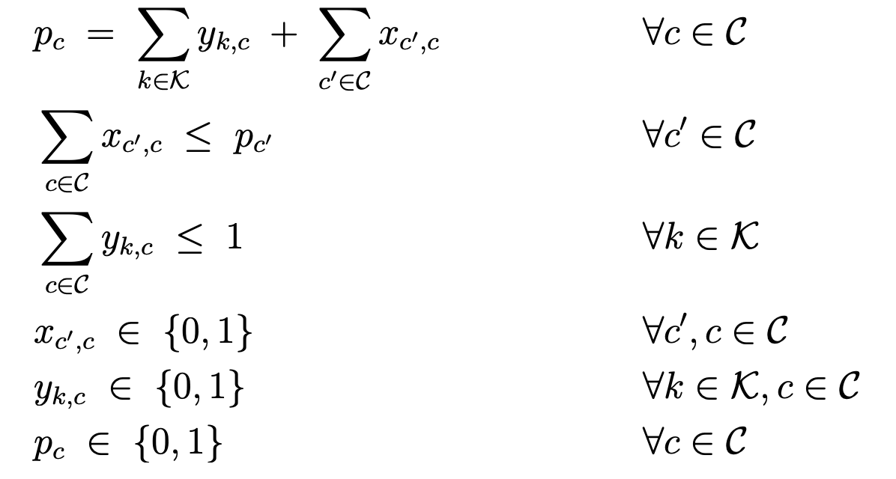
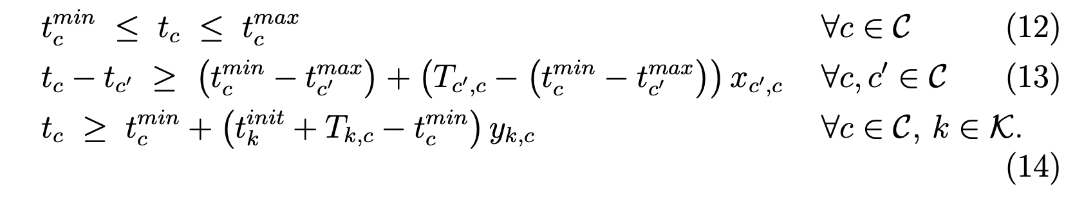
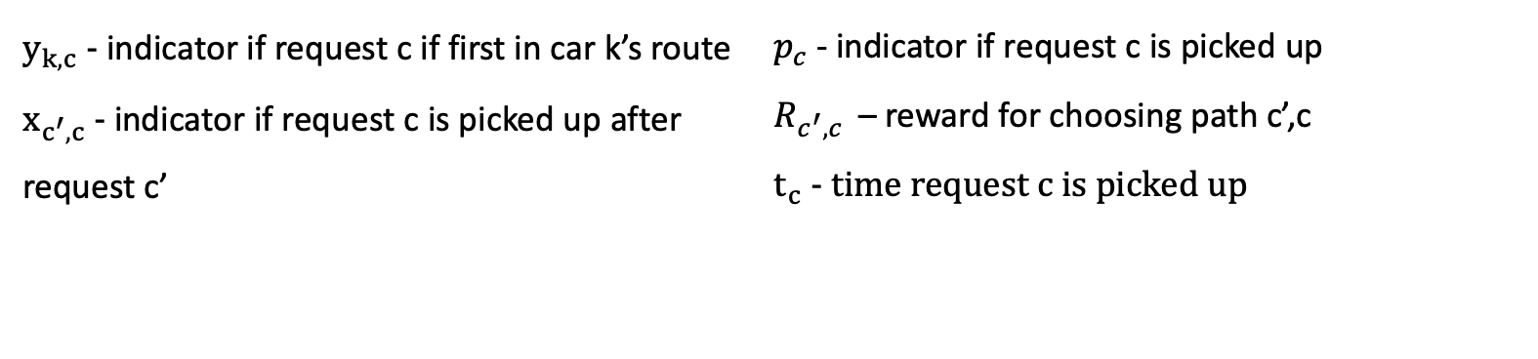
Variables
$y_{k,c}$ - indicator if request c if first in car k’s route
$x_{c^{′},c}$ - indicator if request c is picked up after request c’
$p_{c}$ - indicator if request c is picked up
$R_{c^{′},c }$ – reward for choosing path c’,c
$t_{c}$ - time request c is picked up
Step 3 :
MIP
explained
Constraints
Online Vehicle Routing: The Edge of Optimization in Large-Scale Applications. Operations Research 67(1): 143-162 (2019) Dimitris Bertsimas, Patrick Jaillet, S´ebastien Martin

Slide 22
Input: nodes of graph
Problem is represented as graph
Nodes : locations of all requests
Edges : routes between requests
Encoder –
Multi head attention
Step 3 :
Reinforcement learning
explained
Input to decoder : available nodes + graph embedding
Decoder car 1 –
Multi head attention
Decoder car 2 –
Multi head attention
Decoder car k –
Multi head attention
…
Fully connected layer
Attention, Learn to Solve Routing Problems!, International Conference on Learning Representations
Wouter Kool and Herke van Hoof and Max Welling
output: k probability functions, each one represents if car k will pick up nodes that are still available

Slide 23
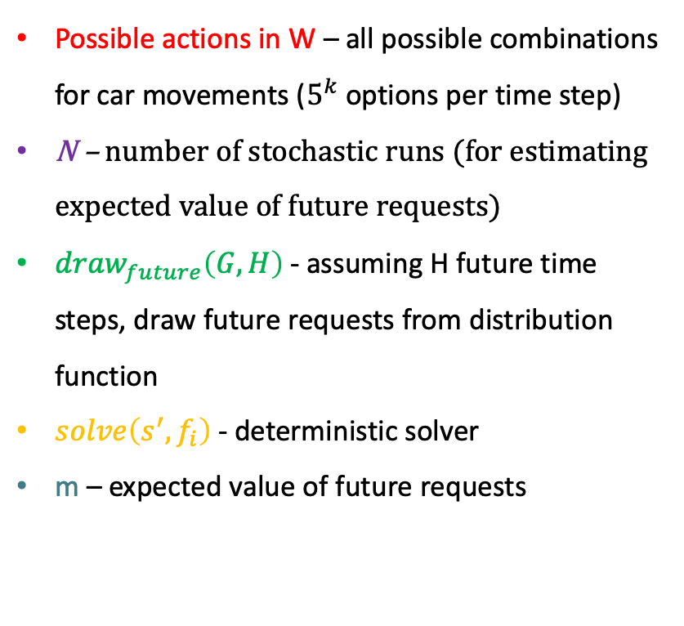
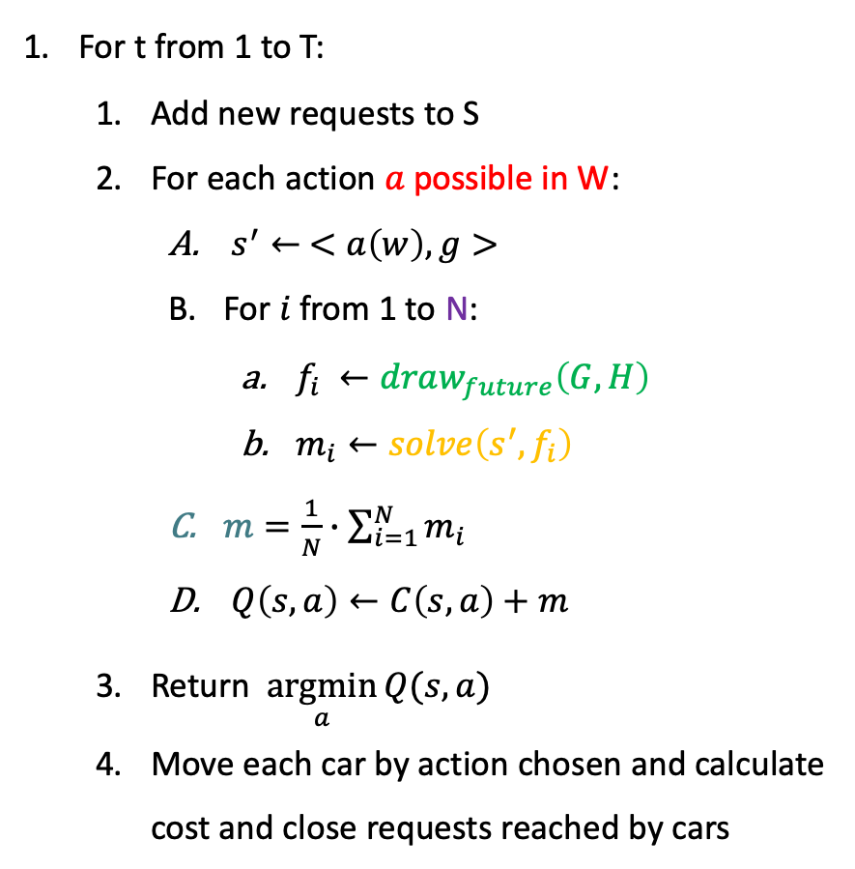
For t from 1 to T:
Add new requests to S
For each action $a$ possible in W:
$s^{′}← <a\left(w\right), g>$
For $i$ from 1 to N:
$f_{i} ←draw_{future}\left(G,H\right)$
$m_{i}←solve\left(s^{′},f_{i}\right)$
$m=\frac{1}{N}∙\sum_{i=1}^{N}{m_{i}}$
$Q\left(s,a\right)←C\left(s,a\right)+m$
Return $\underset{a}{argmin}{Q(s,a)}$
Move each car by action chosen and calculate cost and close requests reached by cars
Possible actions in W – all possible combinations for car movements ($5^{k}$ options per time step)
N – number of stochastic runs (for estimating expected value of future requests)
$draw_{future}\left(G,H\right)$- assuming H future time steps, draw future requests from distribution function
$solve\left(s^{′},f_{i}\right)$ - deterministic solver
m – expected value of future requests
Step 4 :
Anticipatory Algorithm

Slide 24
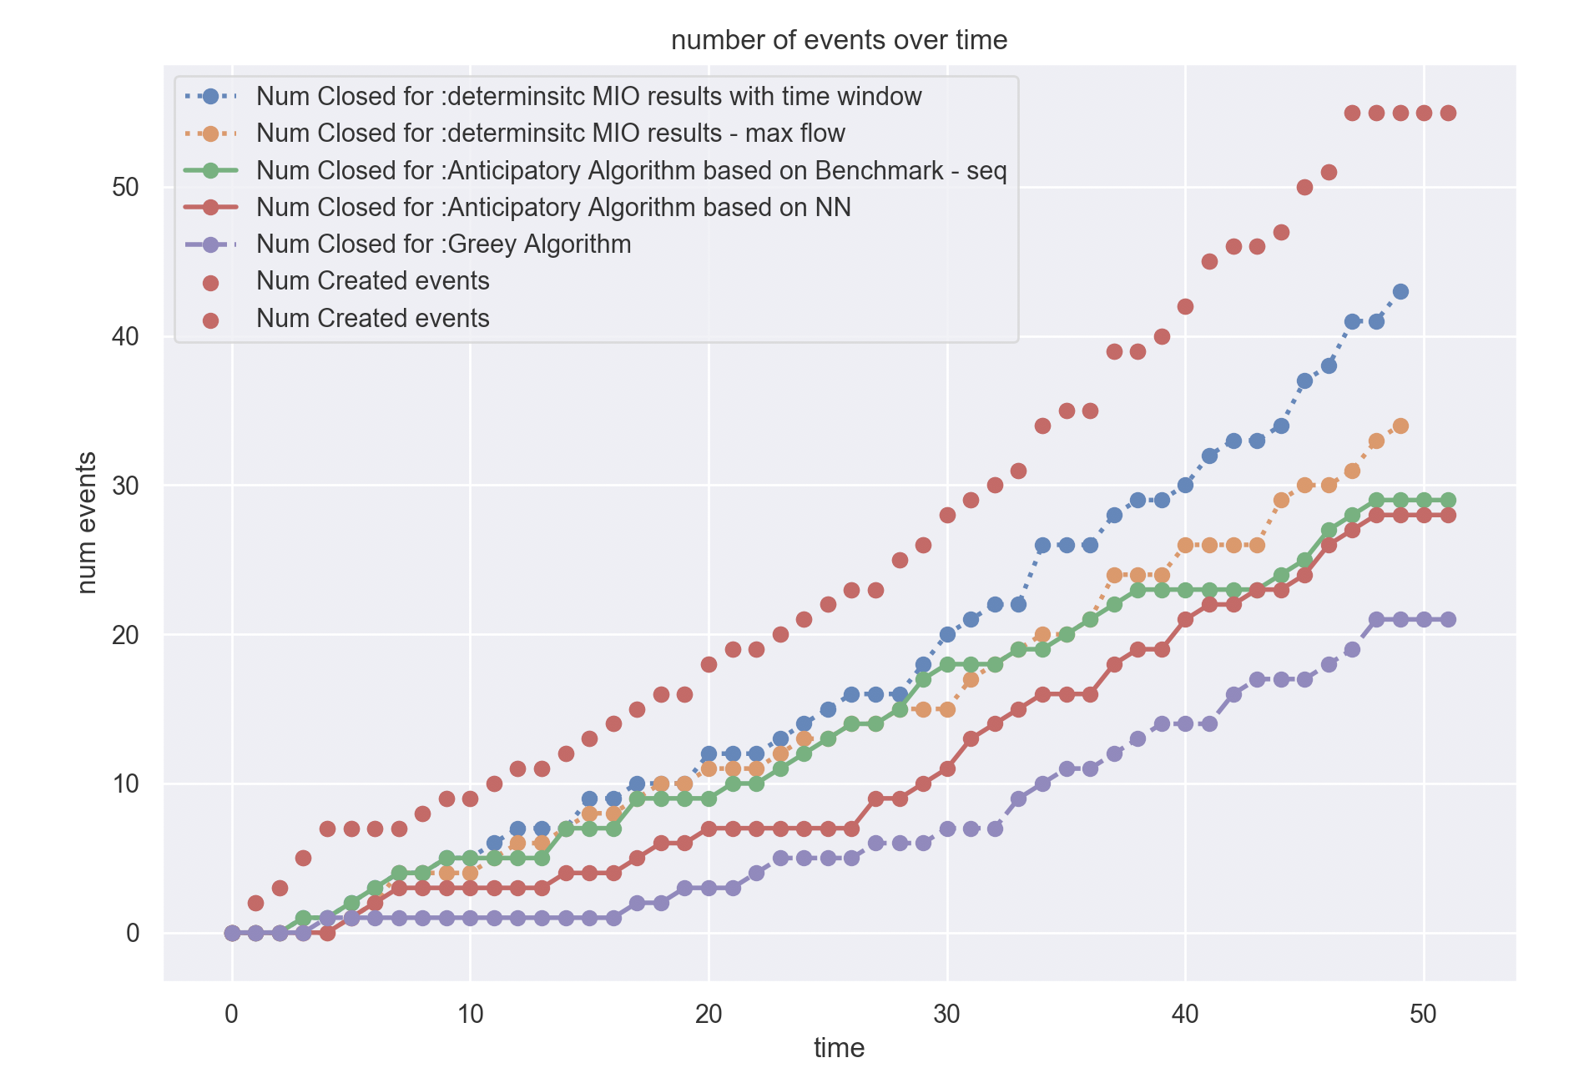
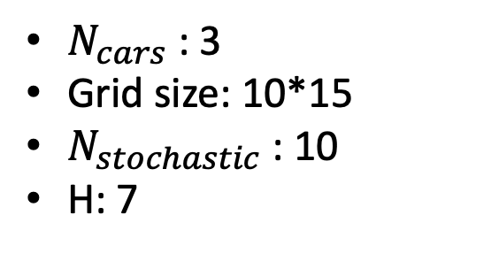
Comparing different prediction algorithms -
Step 4 :
Anticipatory Algorithm
$N_{cars}$ : 3
Grid size: 10*15
$N_{stochastic}$: 10
H: 7
Results with simple prediction function are as good as results with Neural network
Notes:
/Users/chanaross/dev/Thesis/Simulation/Anticipitory/with_machine_learning/NumCars/Results/SimAnticipatoryMio_RandomChoice_7lpred_1000startTime_10gridX_15gridY_55numEvents_10nStochastic_3numCars_Bm_easy_MaxFlow

Slide 25
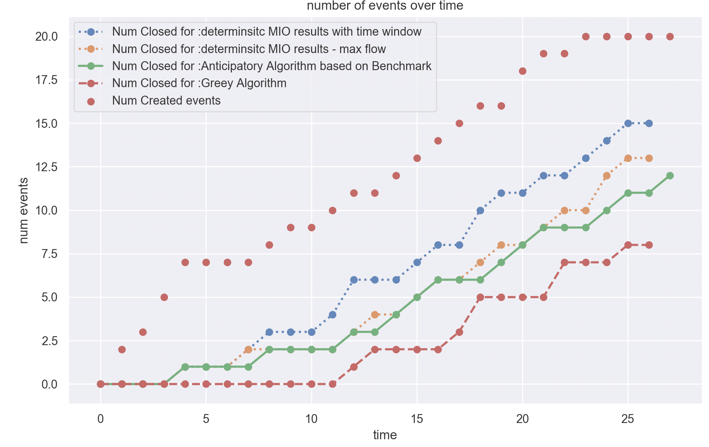
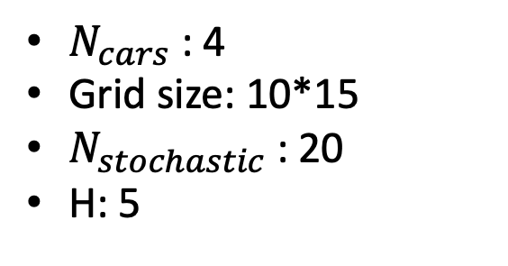
Results , MIP, Max Flow solution -
Step 4 :
Anticipatory Algorithm
$N_{cars}$ : 4
Grid size: 10*15
$N_{stochastic}$: 20
H: 5
Anticipatory algorithm shows great improvement compared to greedy algorithm
Anticipatory is using max flow as deterministic algorithm and shows similar results to deterministic solution
Notes:
/Users/chanaross/dev/Thesis/Simulation/Anticipitory/with_machine_learning/Results_presentation/SimAnticipatoryMio_BruteForce_5lpred_4delOpen_1000startTime_10gridX_15gridY_20numEvents_20nStochastic_4numCars_Bm_MaxFlow.p

Slide 26
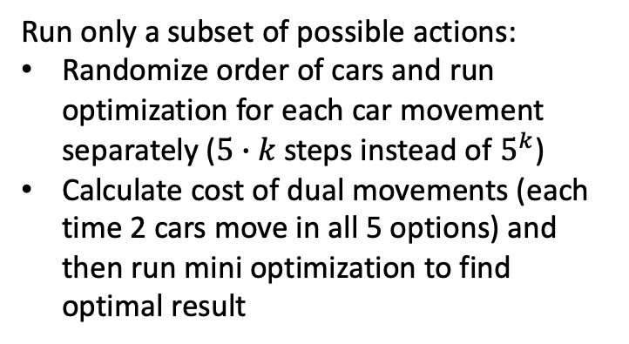
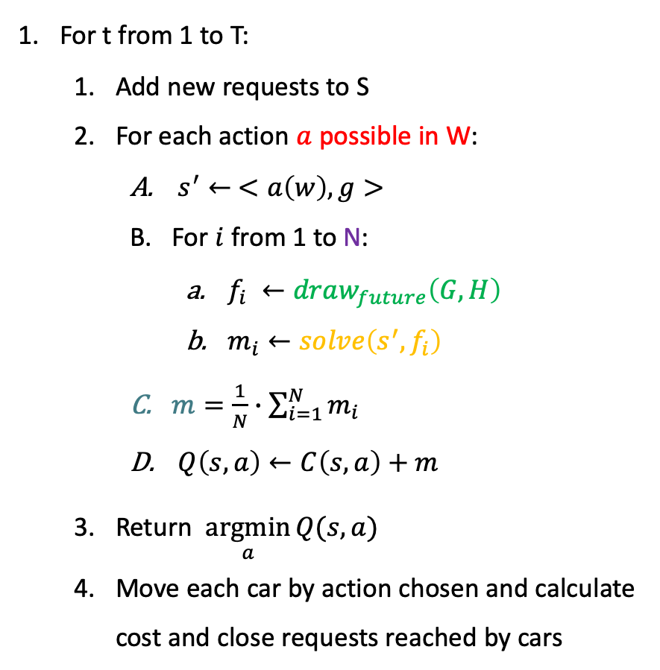
Run only a subset of possible actions:
Randomize order of cars and run optimization for each car movement separately ($5∙k$ steps instead of $5^{k}$)
Calculate cost of dual movements (each time 2 cars move in all 5 options) and then run mini optimization to find optimal result
For t from 1 to T:
Add new requests to S
For each action $a$ possible in W:
$s^{′}← <a\left(w\right), g>$
For $i$ from 1 to N:
$f_{i} ←draw_{future}\left(G,H\right)$
$m_{i}←solve\left(s^{′},f_{i}\right)$
$m=\frac{1}{N}∙\sum_{i=1}^{N}{m_{i}}$
$Q\left(s,a\right)←C\left(s,a\right)+m$
Return $\underset{a}{argmin}{Q(s,a)}$
Move each car by action chosen and calculate cost and close requests reached by cars
Step 5 :
Optimize Run-Time
Reduce deterministic run time:
Run Max flow problem instead of time window (shortens run time gradually since can be run without integer constraints)
Run reinforcement learning on deterministic problem. (shortens run time since now can run all action combinations as batch)

Slide 27
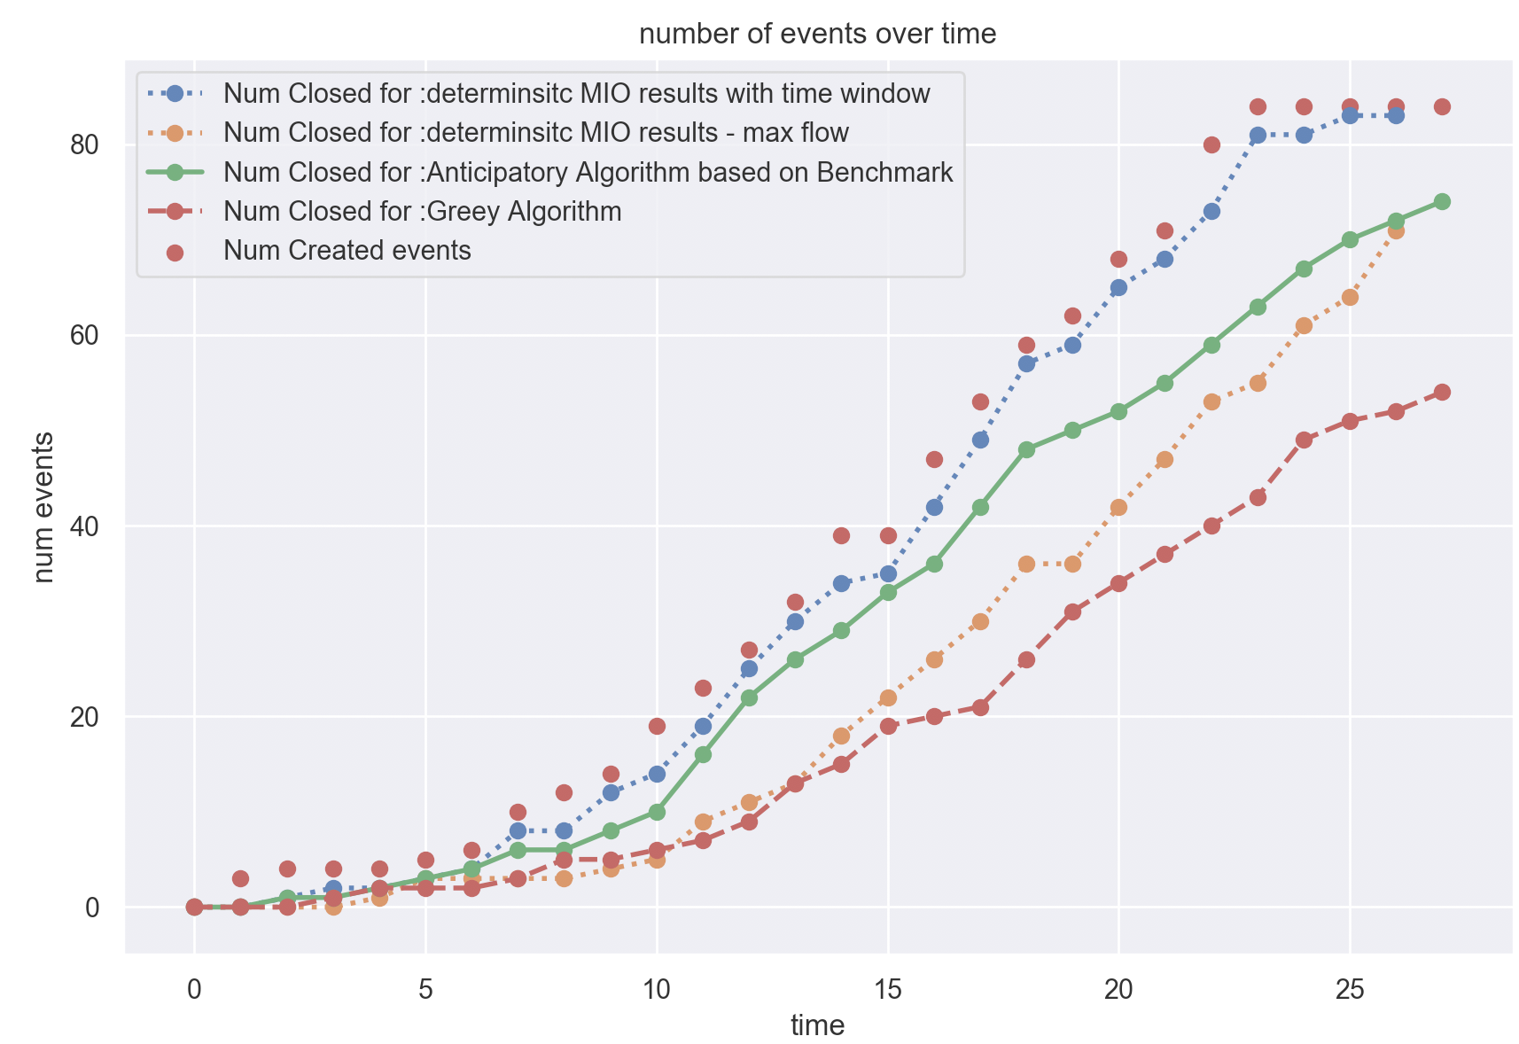
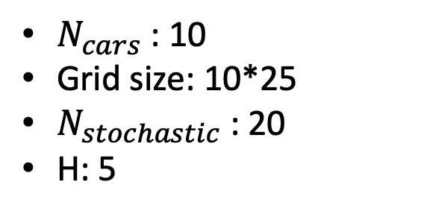
Step 5 :
Optimize Run-Time
$N_{cars}$ : 10
Grid size: 10*25
$N_{stochastic}$: 20
H: 5
Greedy anticipatory solution preforms very well, better than deterministic without time window and solution is not far from optimal solution
Notes:
/Users/chanaross/dev/Thesis/Simulation/Anticipitory/with_machine_learning/Results_presentation/SimAnticipatoryMio_RandomChoice_5lpred_4delOpen_48startTime_10gridX_25gridY_84numEvents_20nStochastic_10numCars_Bm_MaxFlow

Slide 28
Future work
Calculate the stochastic problem using reinforcement learning and anticipatory as the Cost of algorithm
Finish reinforcement learning on the deterministic problem and run anticipatory algorithm in real time on larger problem

Slide 29
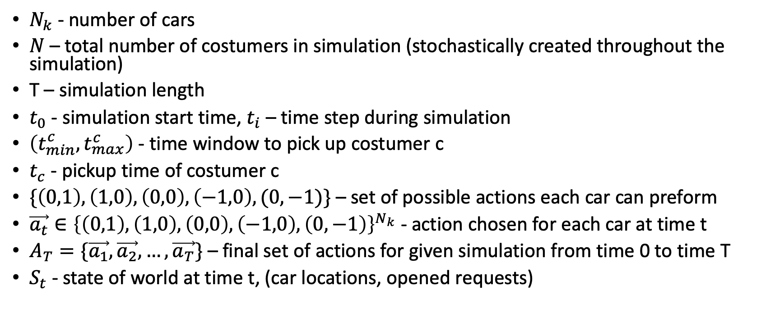
Problem formulation
$N_{k}$ - number of cars
$N$ – total number of costumers in simulation (stochastically created throughout the simulation)
T – simulation length
$t_{0}$ - simulation start time, $t_{i}$ – time step during simulation
$\left(t_{min}^{c},t_{max}^{c}\right)$ - time window to pick up costumer c
$t_{c}$ - pickup time of costumer c
$\{\left(0,1\right),\left(1,0\right),\left(0,0\right),\left(−1,0\right),(0,−1)\}$ – set of possible actions each car can preform
$\vec{a_{t}}∈{\left\{\left(0,1\right),\left(1,0\right),\left(0,0\right),\left(−1,0\right),\left(0,−1\right)\right\}}^{N_{k}}$ - action chosen for each car at time t
$A_{T}=\{\vec{a_{1}},\vec{a_{2}},…,\vec{a_{T}}\}$ – final set of actions for given simulation from time 0 to time T
$S_{t}$ - state of world at time t, (car locations, opened requests)

Slide 30
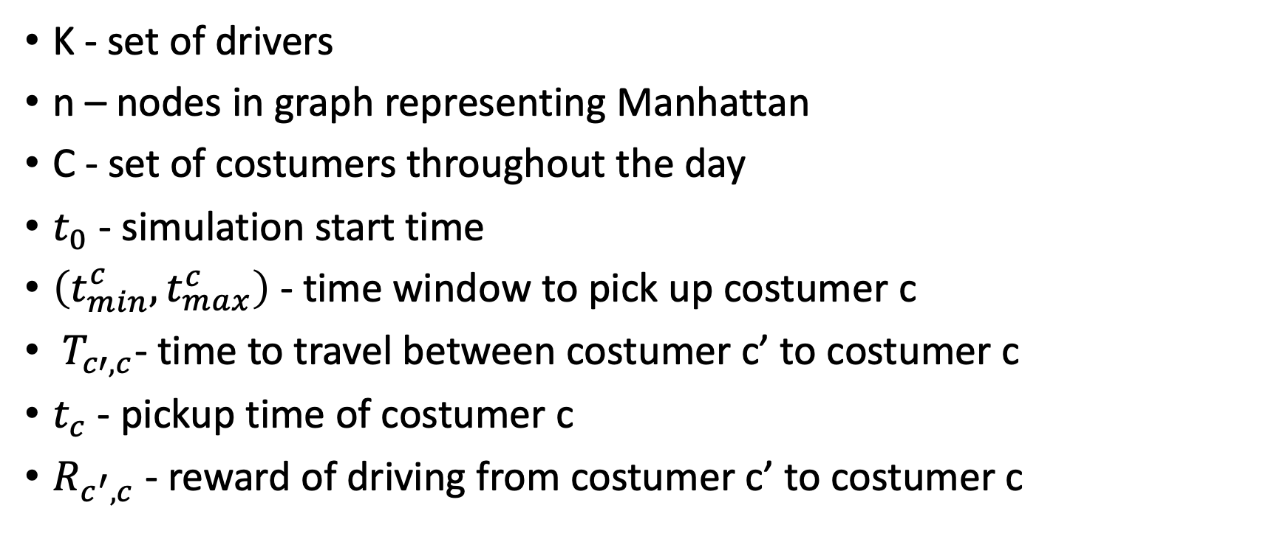
Deterministic problem – Mathematical Definition
K - set of drivers
n – nodes in graph representing Manhattan
C - set of costumers throughout the day
$t_{0}$ - simulation start time
$\left(t_{min}^{c},t_{max}^{c}\right)$ - time window to pick up costumer c
$T_{c′,c}$- time to travel between costumer c’ to costumer c
$t_{c}$ - pickup time of costumer c
$R_{c^{′},c}$ - reward of driving from costumer c’ to costumer c
Notes:
יש ניסוח של הבעיה בתור M|IP שמגיעה מתוך MIT ועם עושים רילסקציה של הזמן עדיין מגיעים לפתרון אופטימאלי

